Slide 1
TNB Business Process
Welcome customer
Booking
Make a contract
Accounting
NCB checking
Finance
Field check
Collection

Slide 2
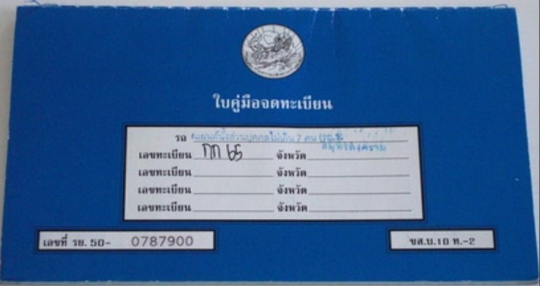
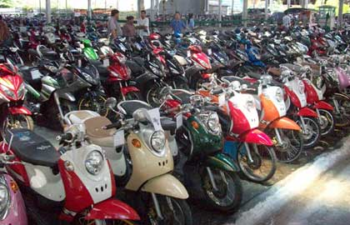
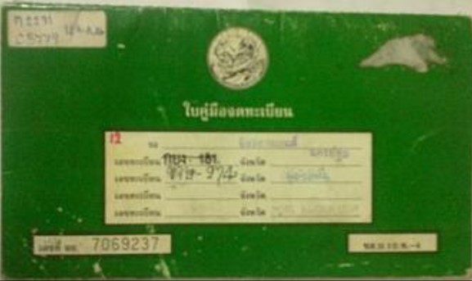
TNB products
Auto loan – Motorcycle and car
Second handed motorcycle

